Slide 1


Welcome you all
MySQL
D.Sakthivel
Assistant Professor & Trainer,
KGiSL Micro College
KGiSL Campus, Coimbatore – 641 035.

Slide 2
Day 1
RDBMS
WHAT IS SQL?
DDL
DML
MySQL
Data types
SELECT QUERY : WHERE CLAUSE - Comparison Operator
Comparison Operator
LIKE OPERATOR
LOGICAL OPERATOR
BETWEEN AND IN
ORDERBY and DISTINCT
AGGREGATE FUNCTION
GROUP BY AND HAVING CLAUSE
OPERATORS
EXPRESSIONS IN QUERYING

Slide 3
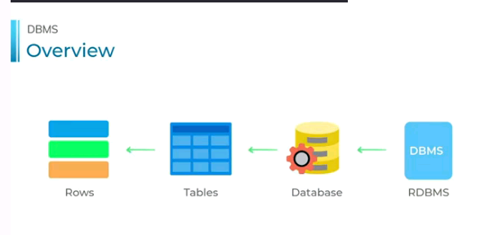
RDBMS
A Relation Database Management system (RDBMS) is a database management system that is based on the relational model.
It has the following major components: Table, Record/Tuple/Row, Field, and Column/Attribute.
Examples of the most popular RDBMS are MYSQL, Oracle, IBM DB2, and Microsoft SQL Server database.

Slide 4
What is Relation Database?
A relational database is a database divided into logical units called tables, where tables are related to one another within the database.
Relational database allows data to be broken down into logical, smaller, and manageable units for easier maintenance and better performance.
Tables are related to one another through common keys or fields in a relational database system.
The desired data may exist in more than one table, you can easily join multiple tables together to get combined data set using a single query.

Slide 5
Setting Up Work Environment for Practicing SQL
You can install a free, open-source DBMS.
MySQL is the most popular and widely supported open-source database management system.
It is very easy to download and use and available for both Windows and Linux (or UNIX) operating system.
You can download it freely from here https://dev.mysql.com/downloads/mysql/

Slide 6
SQL(Structured Query Language)
SQL is a standard language designed for managing data in relational database management system.
SQL stands for Structured Query Language.
SQL is a standard programming language specifically designed for storing, retrieving, managing or manipulating the data inside a relational database management system (RDBMS).
SQL became an ISO standard in 1987.
SQL is the most widely-implemented database language and supported by the popular relational database systems, like MySQL, SQL Server, and Oracle.
However, some features of the SQL standard are implemented differently in different database systems.
SQL was originally developed at IBM in the early 1970s. Initially it was called SEQUEL (Structured English Query Language) which was later changed to SQL (pronounced as S-Q-L).

Slide 7
SQL(Structured Query Language)
There are lot more things you can do with SQL:
You can create a database.
You can create tables in a database.
You can query or request information from a database.
You can insert records in a database.
You can update or modify records in a database.
You can delete records from the database.
You can set permissions or access control within the database for data security.
You can create views to avoid typing frequently used complex queries.

Slide 8

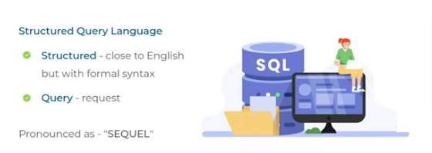

Slide 9
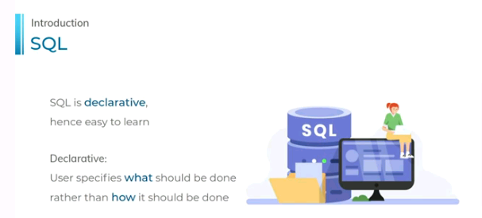

Slide 10
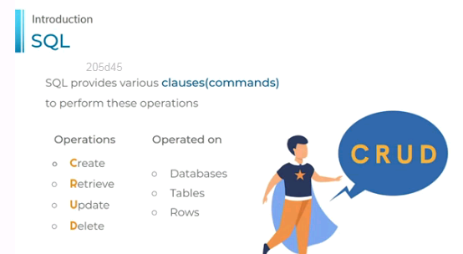

Slide 11
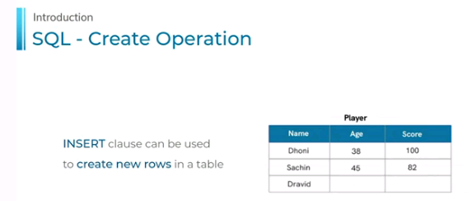
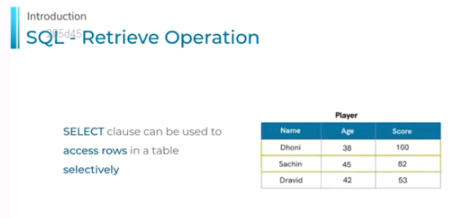

Slide 12
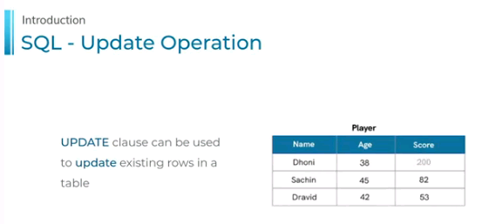
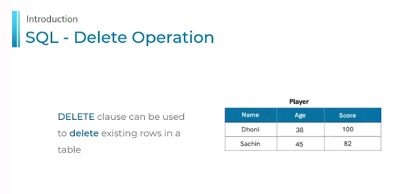

Slide 13
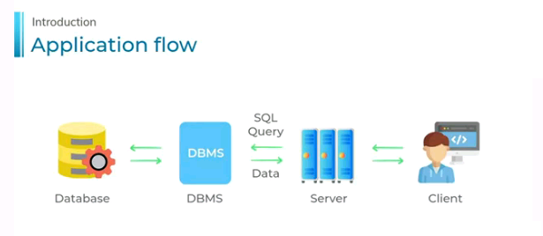

Slide 14
MySQL

Slide 15
Overview
MySQL is a relational database management system based on the Structured Query Language,
MySQL is the popular language for accessing and managing the records in the database.
MySQL is open-source and free software under the GNU license. It is supported by Oracle Company.
It is developed, marketed, and supported by MySQL AB, a Swedish company, and written in C programming language and C++ programming language.
The project of MySQL was started in 1979 when MySQL's inventor Michael Widenius developed an in-house database tool called UNIREG for managing databases.

Slide 16
Data types
Numeric Data type
TINYINT : It is a very small integer that can be signed or unsigned. If signed, the allowable range is from -128 to 127. If unsigned, the allowable range is from 0 to 255. We can specify a width of up to 4 digits. It takes 1 byte for storage.
SMALLINT: It is a small integer that can be signed or unsigned. If signed, the allowable range is from -32768 to 32767. If unsigned, the allowable range is from 0 to 65535. We can specify a width of up to 5 digits. It requires 2 bytes for storage.
MEDIUMINT : It is a medium-sized integer that can be signed or unsigned. If signed, the allowable range is from -8388608 to 8388607. If unsigned, the allowable range is from 0 to 16777215. We can specify a width of up to 9 digits. It requires 3 bytes for storage.
INT : It is a normal-sized integer that can be signed or unsigned. If signed, the allowable range is from -2147483648 to 2147483647. If unsigned, the allowable range is from 0 to 4294967295. We can specify a width of up to 11 digits. It requires 4 bytes for storage.

Slide 17
Data types
Numeric Data type
FLOAT(m,d): It is a floating-point number that cannot be unsigned. You can define the display length (m) and the number of decimals (d). This is not required and will default to 10,2, where 2 is the number of decimals, and 10 is the total number of digits (including decimals). Decimal precision can go to 24 places for a float type. It requires 2 bytes for storage.
DOUBLE(m,d): It is a double-precision floating-point number that cannot be unsigned. This is not required and will default to 16,4, where 4 is the number of decimals. Decimal precision can go to 53 places for a double. It requires 8 bytes for storage.
BOOL: It is used only for the true and false condition. It considered numeric value 1 as true and 0 as false. BOOLEAN It is Similar to the BOOL.

Slide 18
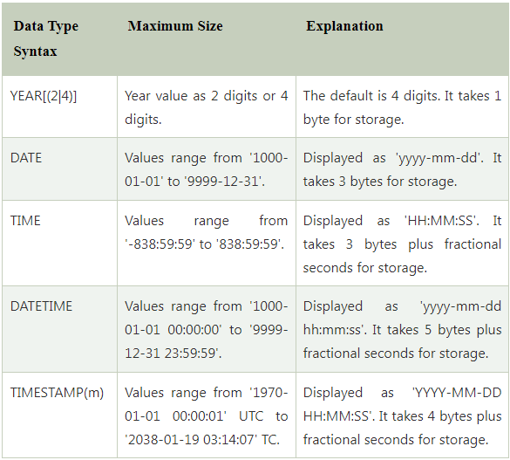
Data types
2. Date and Time Data type

Slide 19
Data types
2. String Data type
CHAR(size) | It can have a maximum size of 255 characters. | Here size is the number of characters to store. Fixed-length strings. Space padded on the right to equal size characters.
VARCHAR(size) | It can have a maximum size of 255 characters. | Here size is the number of characters to store. Variable-length string.
TEXT(size) | Maximum size of 65,535 characters. | Here size is the number of characters to store.

Slide 20
Data types
2. String Data type
CHAR(size) | It can have a maximum size of 255 characters. | Here size is the number of characters to store. Fixed-length strings. Space padded on the right to equal size characters.
VARCHAR(size) | It can have a maximum size of 255 characters. | Here size is the number of characters to store. Variable-length string.
TEXT(size) | Maximum size of 65,535 characters. | Here size is the number of characters to store.

Slide 21
Data types
Data Type | Description
INT | Stores numeric values in the range of -2147483648 to 2147483647
DECIMAL | Stores decimal values with exact precision.
CHAR | Stores fixed-length strings with a maximum size of 255 characters.
VARCHAR | Stores variable-length strings with a maximum size of 65,535 characters.
TEXT | Stores strings with a maximum size of 65,535 characters.
DATE | Stores date values in the YYYY-MM-DD format.
DATETIME | Stores combined date/time values in the YYYY-MM-DD HH:MM:SS format.
TIMESTAMP | Stores timestamp values. TIMESTAMP values are stored as the number of seconds since the Unix epoch ('1970-01-01 00:00:01' UTC).

Slide 22
Create Database:
Syntax:
CREATE DATABASE database_name ;
Example:
mysql> CREATE DATABASE employeesdb;

Slide 23
Create Database:
Syntax:
CREATE DATABASE database_name ;
Example:
mysql> CREATE DATABASE studentdb;
We can review the newly created database using the below query that returns the database name, character set, and collation of the database:
mysql> SHOW CREATE DATABASE studentdb;

Slide 24
To show all Database:
mysql> SHOW DATABASES;
SELECT/Access Database
Syntax:
USE database_name;
Example:
USE studentdb;
SHOW ALL TABLES PRESENT IN A DATABASE:
mysql> SHOW TABLES;
SHOW VERSION OF MYSQL
mysql> select version();
SHOW CURRENT DATE:
mysql> select CURRENT_DATE;

Slide 25
To show all USERS:
mysql> select users();
SHOW CURRENT DATE AND TIME
mysql> select now();
SQL types of query language:
DDL – DATA DEFINITION LANGUAGE
Create, Alter, Truncate, Drop
DML – DATA MANIPULATION LANGUAGE
Select, Insert, Update, Delete
DCL – DATA CONTROL LANGUAGE – GRANT & REVOKE
TCL – TRANSACTION CONTROL LANGAUGE –COMMIT & SAVE POINT

Slide 26
CREATE TABLE:
To Create a table with relevant fields
Syntax:
CREATE TABLE table_name(
column_definition1 DATATYPE,
column_definition2 DATATYPE,
........,
table_constraints
);

Slide 27
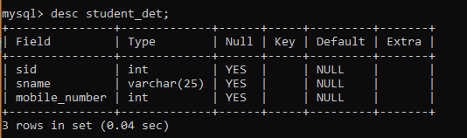
To See the table structure:
Syntax:
mysql> DESC <TABLENAME>;

Slide 28
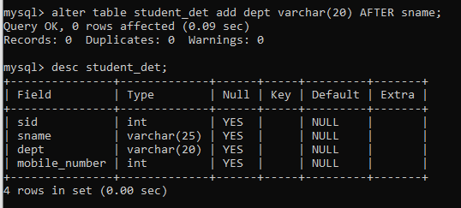
ALTER Table
To add new column in to the created table.
ADD
Syntax:
ALTER TABLE table_name
ADD new_column_name column_definition
[ FIRST | AFTER column_name ];

Slide 29
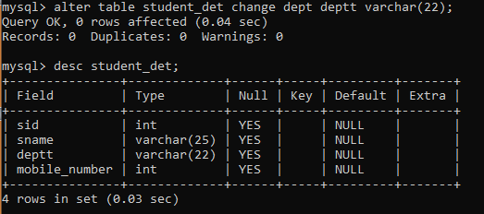
ALTER Table
B) CHANGE – TO rename the column in a table
ALTER TABLE table_name CHANGE old_column_name new_col_name Data Type;

Slide 30
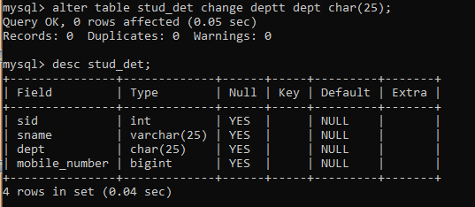
ALTER Table
B) CHANGE – TO rename the column in a table
ALTER TABLE table_name CHANGE old_column_name new_col_name Data Type;

Slide 31
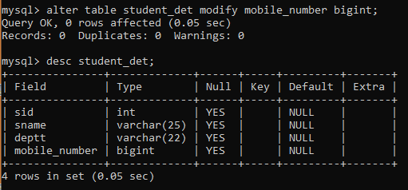
ALTER Table
B) Modify –To change the data type of a column in a table.
Syntax:
ALTER TABLE table_name MODIFY COLUMN column_name datatype;

Slide 32
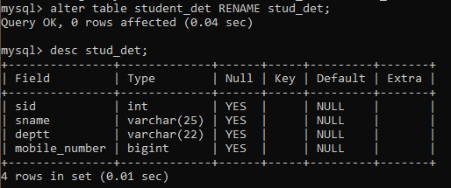
Rename Table:
To Rename a existing table in MySQL.
SYNTAX:
ALTER TABLE old_table RENAME new_table;

Slide 33
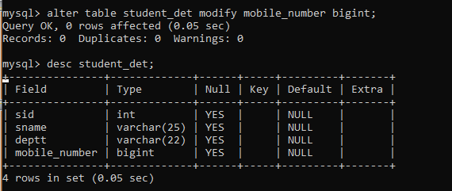
ALTER Table
B) MODIFY – To modify the size/change the data type of a column in a table.
ALTER TABLE table_name
MODIFY column_name column_definition
[ FIRST | AFTER column_name ];

Slide 34
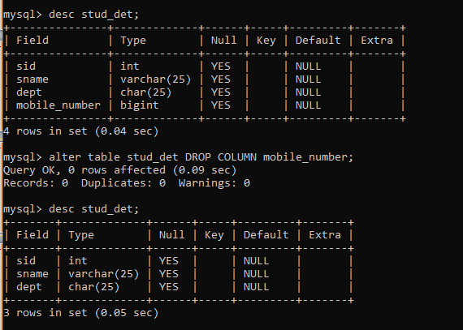
ALTER Table
Drop column in table – To Delete column in a table.
Syntax
ALTER TABLE table_name DROP COLUMN column_name;

Slide 35
TRUNCATE Table:
The TRUNCATE statement in MySQL removes the complete data without removing its structure.
SYNTAX:
TRUNCATE [TABLE] table_name;
DROP Table:
Drop Table statement to delete the existing table.
SYNTAX:
mysql> DROP TABLE table_name;

Slide 36
DROP COLUMN
SYNTAX:
ALTER TABLE table_name DROP COLUMN column_name;
CHANGE COLUMN NAME:
SYNTAX:
ALTER TABLE table_name
CHANGE COLUMN old_column_name new_column_name Data Type;
ALTER TABLE table_name
RENAME COLUMN old_column_name TO new_column_name;

Slide 37

INSERT Statement
SYNTAX: - Single Row Insertion
INSERT INTO table_name ( field1, field2,...fieldN )
VALUES
( value1, value2,...valueN );

Slide 38
INSERT Statement
SYNTAX:
If we want to insert multiple records within a single command, use the following statement:
INSERT INTO table_name VALUES
( value1, value2,...valueN ) ,
( value1, value2,...valueN ),
...........
( value1, value2,...valueN );

Slide 39
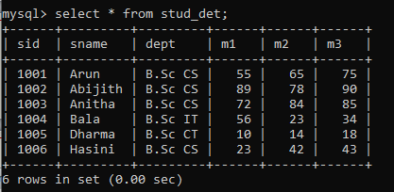
SELECT Statement
SYNTAX:
SELECT field_name1, field_name 2,... field_name
FROM table_name1, table_name2...
[WHERE condition]
[GROUP BY field_name(s)]
[HAVING condition]
[ORDER BY field_name(s)] ;
Selecting All Columns
SELECT *FROM table_name;
Selecting Specific Rows
SELECT * FROM table_nameWHERE condition;

Slide 40
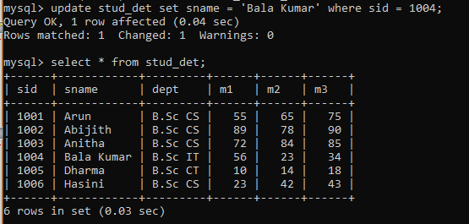
UPDATE QUERY
SYNTAX:
UPDATE table_name
SET column_name1 = new-value1,
column_name2=new-value2, ...
[WHERE Clause]

Slide 41
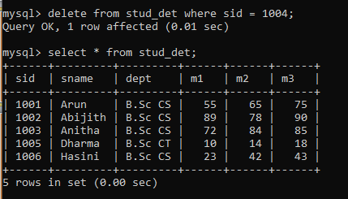
DELETE QUERY
SYNTAX:
DELETE FROM table_name WHERE condition;

Slide 42
SELECT QUERY - WHERE CLAUSE
Comparison Operator
LIKE OPERATOR
LOGICAL OPERATOR
BETWEEN AND IN
ORDERBY and DISTINCT
AGGREGATE FUNCTION
GROUP BY AND HAVING CLAUSE
OPERATORS
SET OPERATIONS – UNION & UNION ALL

Slide 43
SQL WHERE Clause
Selecting Record Based on Condition
The WHERE clause is used with the SELECT, UPDATE, and DELETE.
Syntax
The WHERE clause is used with the SELECT statement to extract only those records that fulfill specified conditions. The basic syntax can be given with:
SELECT column_list FROM table_name WHERE condition;
Here, column_list are the names of columns/fields like name, age, country etc. of a database table whose values you want to fetch.
However, if you want to fetch the values of all the columns available in a table, you can use the following syntax:
SELECT * FROM table_name WHERE condition;

Slide 44
Operators Allowed in WHERE Clause
SQL supports a number of different operators that can be used in WHERE clause, the most important ones are summarized in the following table.
Operator | Description | Example
= | Equal | WHERE id = 2
> | Greater than | WHERE age > 30
< | Less than | WHERE age < 18
>= | Greater than or equal | WHERE rating >= 4
<= | Less than or equal | WHERE price <= 100
LIKE | Simple pattern matching | WHERE name LIKE 'Dav'
IN | Check whether a specified value matches any value in a list or subquery | WHERE country IN ('USA', 'UK')
BETWEEN | Check whether a specified value is within a range of values | WHERE rating BETWEEN 3 AND 5

Slide 45
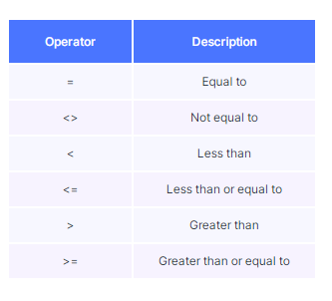
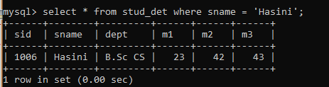
COMPARISON OPERATOR:
EXAMPLE:
SELECT *FROM stud_det WHERE sname = “Hasini";

Slide 46
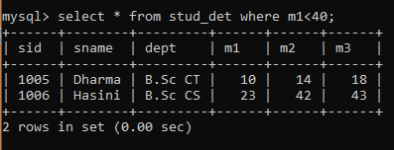
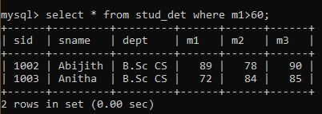
COMPARISON OPERATOR:
EXAMPLE:
SELECT *FROM product WHERE m1 < 40;

Slide 47
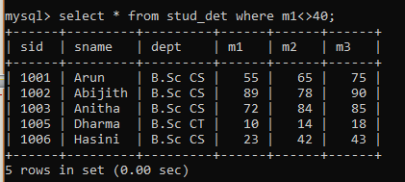
COMPARISON OPERATOR:

Slide 48
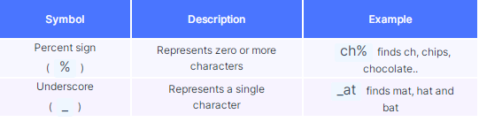
LIKE OPERATOR
The LIKE operator is used in a WHERE clause to search for a specified pattern in a column.
LIKE Operator
LIKE operator is used to perform queries on strings. This operator is especially used in WHERE clause to retrieve all the rows that match the given pattern.

Slide 49
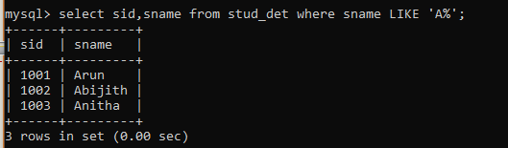
LIKE OPERATOR
Consider the case of e-commerce platforms. We generally search for the products on the basis of product name. But while searching, we need not enter the full name. For example, typing “mobiles” in a search bar will fetch thousands of results.
Syntax:
SELECT columnname1,columnname2 FROM Tablename WHERE columnname LIKE PATTERN;

Slide 50
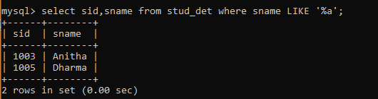
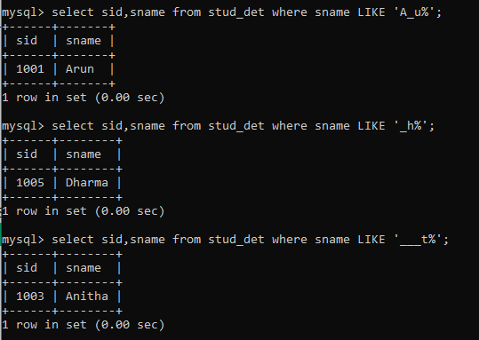
LIKE OPERATOR

Slide 51
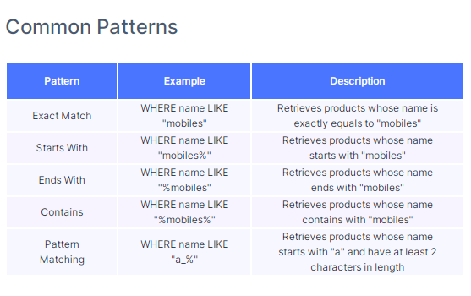
String Operations

Slide 52
String Operations
Syntax
SELECT * FROM table_name WHERE c1 LIKE matching_pattern;
EXAMPLE:
SELECT *FROM product WHERE category LIKE "Gadgets";
SELECT *FROM product WHERE name LIKE "Bourbon%";
SELECT *FROM product WHERE name LIKE "%Smart%";

Slide 53
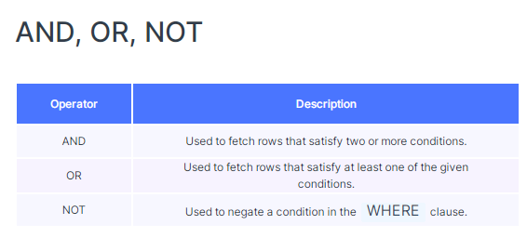
Logical Operators
If you want to combine more than one condition, then you need to use the Logical Operators in MySQL.
The Logical Operators are used to check for the truthiness of some conditions.
Logical operators return a Boolean data type with a value of TRUE, FALSE, or UNKNOWN.
But in real-world scenarios, we often have to retrieve the data using several conditions at once.

Slide 54
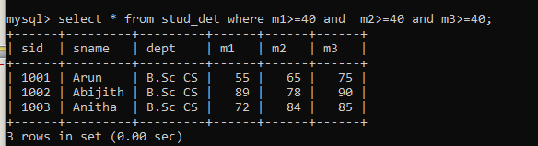
Logical Operators:
AND OPERATOR: The AND operator displays a record if all the conditions separated by AND are TRUE.
SYNTAX:
SELECT column1, column2, ... FROM table_name WHERE condition1 AND condition2 AND condition3 ...;

Slide 55
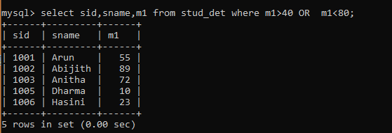
Logical Operators:
OR OPERATOR: The OR operator displays a record if any of the conditions separated by OR is TRUE.
SYNTAX:
SELECT column1, column2, ... FROM table_name WHERE condition1 OR condition2 OR condition3 ...;

Slide 56
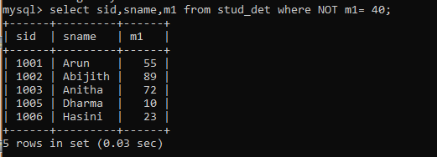
Logical Operators:
NOT OPERATOR: The NOT operator displays a record if the condition(s) is NOT TRUE.
SYNTAX:
SELECT column1, column2, ... FROM table_name WHERE NOT condition;

Slide 57
String Operations
Syntax
SELECT *FROM table_name WHERE condition1 operator condition2 operator condition3 ...;
EXAMPLE:
SELECT *FROM product WHERE category = "Clothing" AND price <= 1000;
SELECT *FROM product WHERE (brand = "Redmi" AND rating > 4) OR brand = "OnePlus";

Slide 58
IN Operators
We use the IN operator to check if a value is present in the list of values.
The IN operator allows you to specify multiple values in a WHERE clause.
The IN operator is a shorthand for multiple OR conditions.
IN Syntax
SELECT column_name(s) FROM table_name WHERE column_name IN (value1, value2, ...);

Slide 59
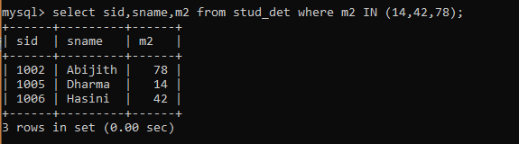
IN Operators

Slide 60
BETWEEN Operators
The BETWEEN operator selects values within a given range. The values can be numbers, text, or dates.
The BETWEEN operator is inclusive: begin and end values are included.
Syntax:
SELECT column_name(s) FROM table_name WHERE column_name BETWEEN value1 AND value2;

Slide 61
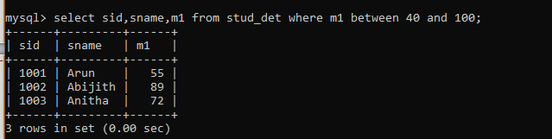
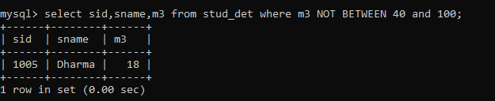
BETWEEN Operators
NOT BETWEEN Operators

Slide 62
IN and BETWEEN Operators
Consider the case of a typical e-commerce scenario. Users generally search for the products that belong to a list of brands, or the products that lie within a particular price range.
In such scenarios, we use the IN operator to check if a value is present in the list of values. And, BETWEEN operator is used to check if a particular value exists in the given range.

Slide 63
IN OPERATOR
Syntax
SELECT *FROM table_nameWHERE c1 IN (v1, v2,..);
EXAMPLE:
SELECT *FROM product WHERE brand IN ( "Puma", "Levi's", "Mufti", "Lee", "Denim");

Slide 64
BETWEEN OPERATOR
Syntax:
SELECT *FROM table_name WHERE c1 BETWEEN v1 AND v2;
EXAMPLE:
SELECT name, price, brand FROM product WHERE price BETWEEN 1000 AND 5000;

Slide 65
ORDER BY
Generally when you use the SELECT statement to fetch data from a table, the rows in result set are not in any particular order.
If you want your result set in a particular order, you can specify the ORDER BY clause at the end of the statement which tells the server how to sort the data returned by the query.
The default sorting order is ascending.
Syntax
The ORDER BY clause is used to sort the data returned by a query in ascending or descending order.
The basic syntax of this clause can be given with:
SELECT column_list FROM table_name ORDER BY column_name ASC|DESC;

Slide 66
ORDER BY
The ORDER BY keyword is used to sort the result-set in ascending or descending order.
The ORDER BY keyword sorts the records in ascending order by default.
To sort the records in descending order, use the DESC keyword.
Syntax
SELECT column1, column2, ... FROM table_name ORDER BY column1, column2, ... ASC|DESC;

Slide 67
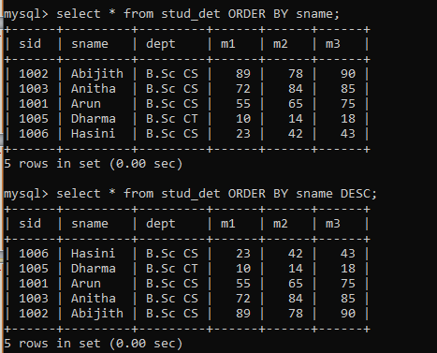
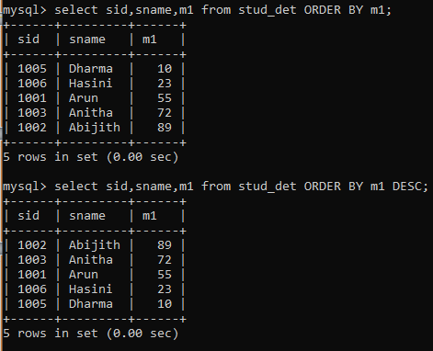
ORDER BY

Slide 68
DISTINCT
The SELECT DISTINCT statement is used to return only distinct (different) values.
Inside a table, a column often contains many duplicate values; and sometimes you only want to list the different (distinct) values.
Syntax:
SELECT DISTINCT column1, column2, ... FROM table_name;

Slide 69
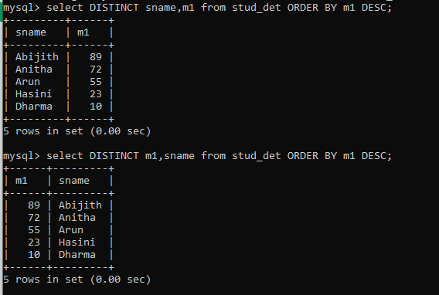
DISTINCT

Slide 70
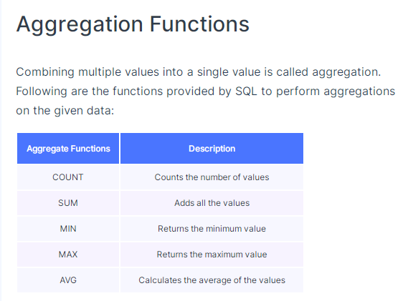
Aggregations:
Consider the case of sports tournaments like cricket. Players’ performances are analysed based on their batting average, maximum number of sixes hit, the least score in a tournament, etc.
We perform aggregations in such scenarios to combine multiple values into a single value, i.e., individual scores to an average score.

Slide 71
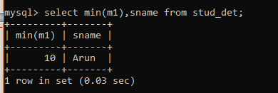
The MIN() function returns the smallest value of the selected column.
Syntax:
SELECT MIN(column_name) FROM table_name WHERE condition;

Slide 72
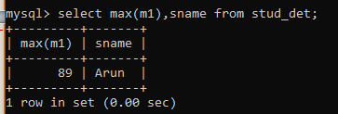
The MAX() function returns the largest value of the selected column.
Syntax:
SELECT MAX(column_name) FROM table_name WHERE condition;

Slide 73
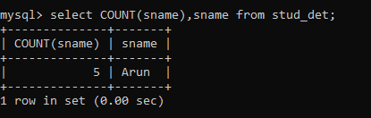
COUNT():
The COUNT() function returns the number of rows that matches a specified criterion.
SYNTAX:
SELECT COUNT(column_name) FROM table_name WHERE condition;

Slide 74
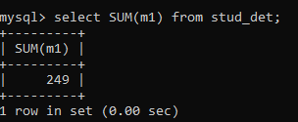
SUM():
The SUM() function returns the total sum of a numeric column. .
SYNTAX:
SELECT SUM(column_name) FROM table_name WHERE condition;

Slide 75
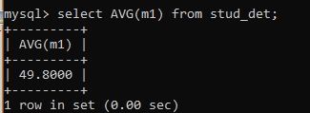
AVG():
The AVG() function returns the average value of a numeric column
SYNTAX:
SELECT AVG(column_name) FROM table_name WHERE condition;

Slide 76
Syntax:
SELECT aggregate_function(c1), aggregate_function(c2) FROM TABLE;
EXAMPLE:
SELECT SUM(score)FROM player_match_detailsWHERE name = "Ram";
ELECT MAX(score), MIN(score)FROM player_match_detailsWHERE year = 2011;
SELECT COUNT(*) FROM player_match_details;

Slide 77
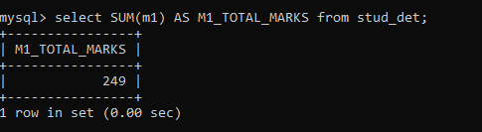
Alias
SQL aliases are used to give a table, or a column in a table, a temporary name.
Aliases are often used to make column names more readable.
An alias only exists for the duration of that query.
An alias is created with the AS keyword.
SYNTAX:
SELECT column_name AS alias_name FROM table_name;

Slide 78
Alias
Using the keyword AS , we can provide alternate temporary names to the columns in the output.
Syntax:
SELECT c1 AS a1, c2 AS a2, ...FROM table_name;
EXAMPLE:
SELECT name AS player_name FROM player_match_details;
SELECT AVG(score) AS avg_score FROM player_match_details;

Slide 79
GROUP BY
The GROUP BY clause in SQL is used to group rows which have same values for the mentioned attributes.
The MySQL GROUP BY Clause returns an aggregated data (value) by grouping one or more columns.
It first groups the columns and then applies the aggregated functions on the remaining columns.
To display the high-level or aggregated information, you have to use this MySQL Group by clause
Syntax:
SELECT c1, aggregate_function(c2)FROM table_name GROUP BY c1;

Slide 80
MySQL GROUP BY
The syntax as:
SELECT [Column1],...[ColumnN], Aggregate Function(Column_Name) FROM [Source] WHERE [Conditions] -- Optional GROUP BY [Column1],...[ColumnN] ORDER BY Columns.
Column1…N: Choose the columns from a table(s).
Aggregate Functions: Use any of the aggregate functions. COUNT, SUM, AVG, AVG, MIN, MAX, STD, and VARIANCE are the functions that we can use.
Group By: Columns that are not part of an Aggregate Function have to place after this.

Slide 81
Group By:
The GROUP BY statement groups rows that have the same values into summary rows, like "find the total marks of number of students in each subject".
The GROUP BY statement is often used with aggregate functions (COUNT(), MAX(), MIN(), SUM(), AVG()) to group the result-set by one or more columns.
SYNTAX:
SELECT column_name(s) FROM table_name WHERE condition GROUP BY column_name(s) ORDER BY column_name(s);

Slide 82
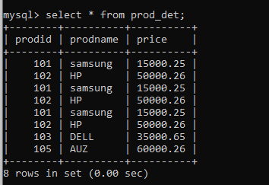
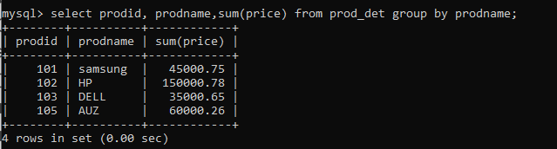
MySQL GROUP BY CLAUSE

Slide 83

MySQL GROUP BY

Slide 84

MySQL GROUP BY

Slide 85
HAVING
HAVING clause is used to filter the resultant rows after the application of GROUP BY clause.
The MySQL Having Clause restricts the number of records or rows returned by the Group By Clause.
To use MySQL Having Clause, we have to use Group By.
It is because the Having is applied after the Group by.
Syntax:
SELECT c1, c2, aggregate_function(c1)FROM table_nameGROUP BY c1, c2HAVING condition;

Slide 86
MySQL HAVING CLAUSE
Syntax:
SELECT [Column1],...[ColumnN], Aggregate_Function(Column_Name) FROM [Source] WHERE [Conditions] -- Optional GROUP BY [Column1],...[ColumnN] HAVING [Conditions] -- Condition is on Aggregate Function(Column_Name)
Column1…N: Choose the columns from a table(s).
Aggregate Functions: Use any of the aggregate functions. COUNT, SUM, AVG, AVG, MIN, MAX, STD, and VARIANCE are the functions that we can use.
Group By: Columns that are not part of an Aggregate Function have to place after this Group by.
Having: We can provide the Filters or apply Conditions on the Aggregated Data that we got from the Group By.

Slide 87



MySQL HAVING CLAUSE

Slide 88

Expressions in Querying
We can write expressions in various SQL clauses.
Expressions can comprise of various data types like integers, floats, strings, datetime, etc.

Slide 89

Expressions in Querying

Slide 90

Using Expressions in WHERE Clause

Slide 91

Using Expressions in UPDATE Clause

Slide 92

Expressions in HAVING Clause

Slide 93



Thank You

